Slide 1

Anomaly Detection Using Federated Learning
Presented By Team 11
Pavan Raj Dasari
Sahithi Thota
Sai Ganesh Pamarti

Slide 2

Presentation Outline
Introduction
Objectives
Approaches
Progress
Future work
Q&A

Slide 3
Introduction
In order to train a machine learning model, do users have to share their data?
What if data is confidential?
ML models need all user data to be aggregated into one unit in order to be trained?
Can’t we just use data in distributed locations?
Is it necessary to have high computing power to train machine learning algorithms?
Can we use multiple small processors to train an ML model?
All problems one solution federated learning

Slide 4
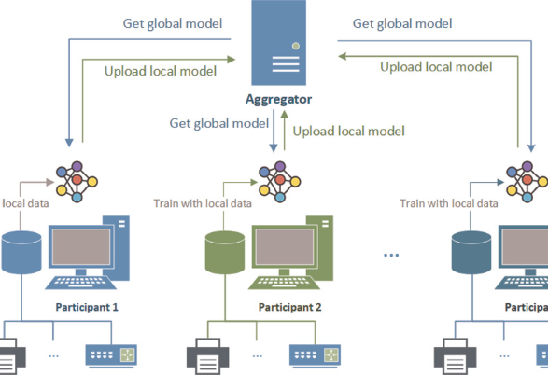
What is Federated Learning?
Federated learning is a machine learning technique where a model is trained across multiple devices or nodes in a decentralized network, without transferring the raw data from each device to a central
location.
Federated learning in anomaly detection involves the following steps:
Data collection
Local training
Model aggregation
Model evaluation
img src:https://static-02.hindawi.com/articles/scn/volume-2022/2913293/figures/2913293.fig.003.jpg

Slide 5

What is an Anomaly?
Anomalies are unusual measurements that may be obtained from sensors in a wireless sensor network.
Different types of anomalies:
Sudden spikes or drops in sensor reading
Unexpected node failures
Unusual energy consumption
Malfunctioning nodes

Slide 6

Objectives
To simulate anomaly detection using Federated learning.
To identify and eliminate the Malicious nodes in the network.
Reduce the privacy concerns on the data.
Minimize the computing power by using distributed systems.

Slide 7
Approaches
For network simulation we are using ns3
We are going to use neural networks with linear basis (y = wx + b) in the nodes
Optimization function - Stochastic gradient descendant(sgd) or Adams
Loss function - Cross Entropy
Activation - RELU
And for global model we are using federated averaging algorithm
w_{t+1} w_{t} + 1/n ∑^{N}_{n=1} F^{n}_{t+1}
where ∑^{N}_{n=1} F^{n}_{t+1} indicates model updates aggregation function,
(1/n) ∑^{N}_{n=1} F^{n}_{t+1} denotes average aggregation

Slide 8
To keep it simple..
Aggregate these weights (FedAVG)
Once we have local weights send these weights to global model and find new wights using the FedAVG algorithm.
Initial Aim is to find Global Weights
We need to input dataset to global model and find the initial weight input (w)
04
Repeat Until Model Converge
01
03
Send global weight to sensor nodes
Once we have global weights we need to input these weights to the nodes in network..
Re-train models and find new weights
We need to retrain our model using the global weights and local data to get new weights
02

Slide 9

Progress
Name | Task | Contribution Percentage
Pavan Raj Dasari | Implementation of federated learning algorithms in order to work with ns3 ML | 33.4%
Sahithi Thota | Network topology for working model of federated learning | 33.3%
Sai Ganesh Pamarti | Data Set Creation for initial training using jamming techniques in ns3 | 33.3%

Slide 10
Future Work
When Federated Learning is used, energy consumption in WSN is compromised?
Storage / Memory
Network Bandwidth
Computation resources
Once we have the setup for simulating federated learning is ready we will be focusing on any one of the major concern regarding energy consumption.

Slide 11

References
FEDERATED LEARNING FOR MOBILE KEYBOARD PREDICTION (https://arxiv.org/pdf/1811.03604v2.pdf)
ns3-fl: Simulating Federated Learning with ns-3 (https://cseweb.ucsd.edu/~x1yu/docs/wns32022/ekaireb2022ns3fl.pdf)
A Joint Learning and Communications Framework for Federated Learning over Wireless Networks (arxiv.org/pdf/1909.07972.pdf)
A Federated Learning Approach to Anomaly Detection in Smart Buildings (https://arxiv.org/pdf/2010.10293.pdf)
Federated Learning with Anomaly Client Detection and Decentralized Parameter Aggregation (ieeexplore.ieee.org/document/9833835)

Slide 12

Any Questions?

